Slide 1
CPSC 483 Data Mining and Pattern Recognition
Group Project
Kaggle Competition
Team : Anonymous
-Anurag Patsariya
-Nitesh Joshi
-Vidhi Patel

Slide 2
Competition Chosen
San Francisco Crime Classification
https://www.kaggle.com/c/sf-crime

Slide 3
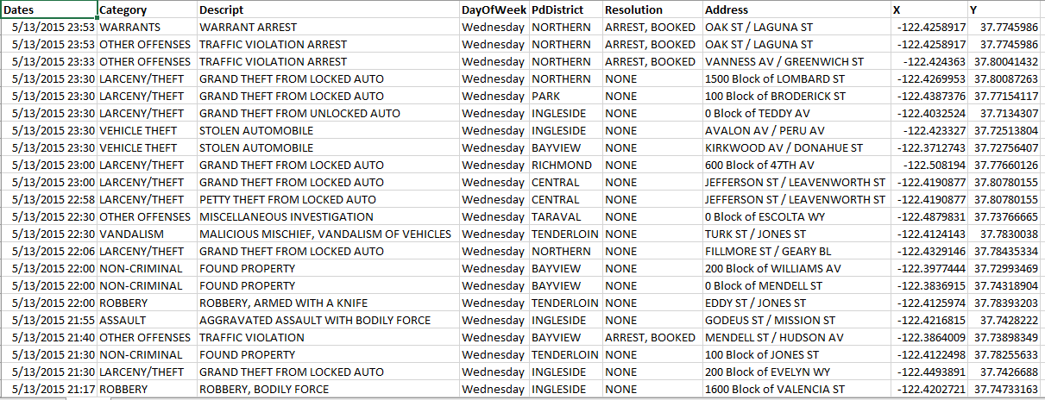
Details of Data Set
This dataset contains incidents derived from SFPD Crime Incident Reporting system. The data ranges from 1/1/2003 to 5/13/2015. The training set and test set rotate every week, meaning week 1,3,5,7... belong to test set, week 2,4,6,8 belong to training set.

Slide 4
Data fields
Dates - timestamp of the crime incident.
Category - category of the crime incident.
Descript - detailed description of the crime incident.
DayOfWeek - the day of the week.
PdDistrict - name of the Police Department District
Resolution - how the crime incident was resolved.
Address - the approximate street address of the crime incident.
X - Longitude.
Y - Latitude.

Slide 5
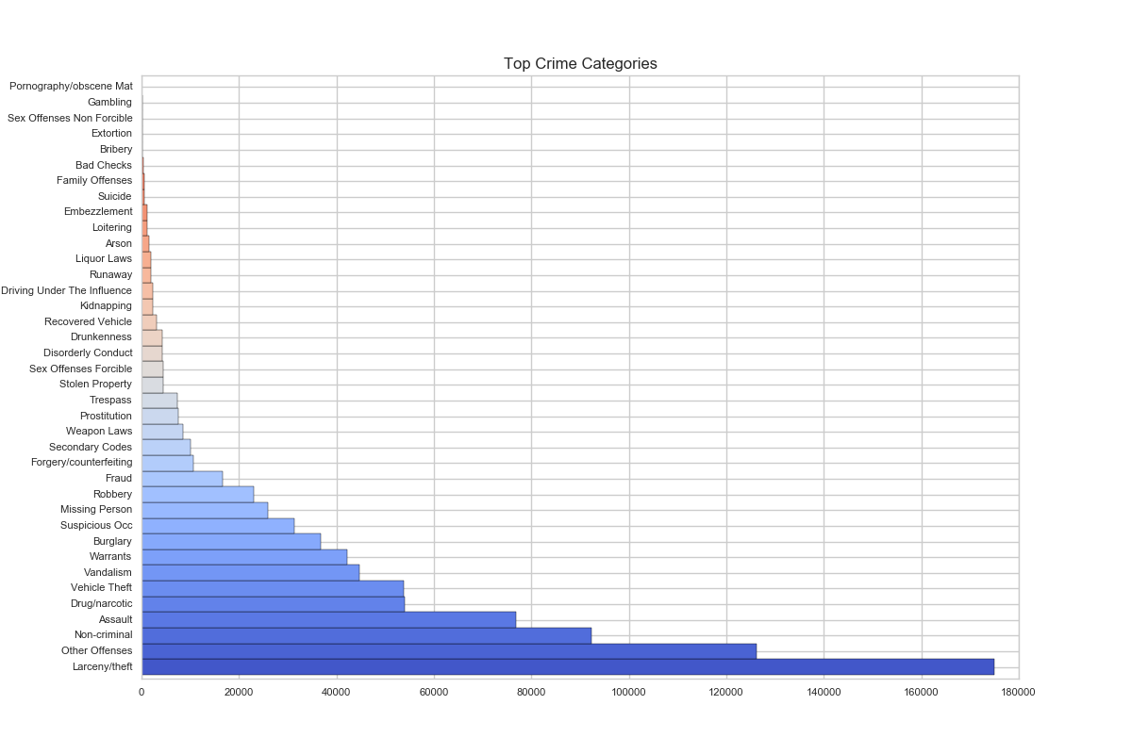
Statistics of Training Data

Slide 6
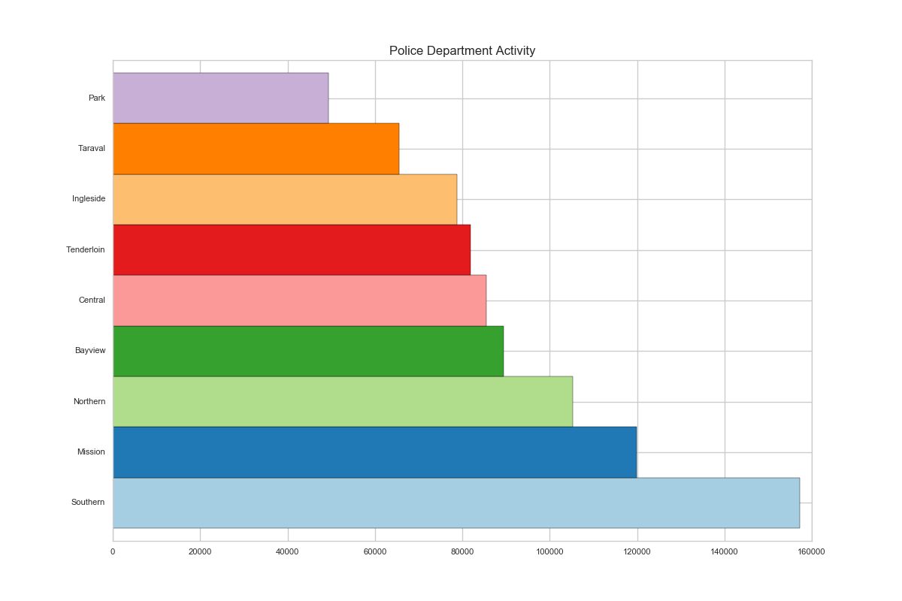
Statistics of Training Data

Slide 7
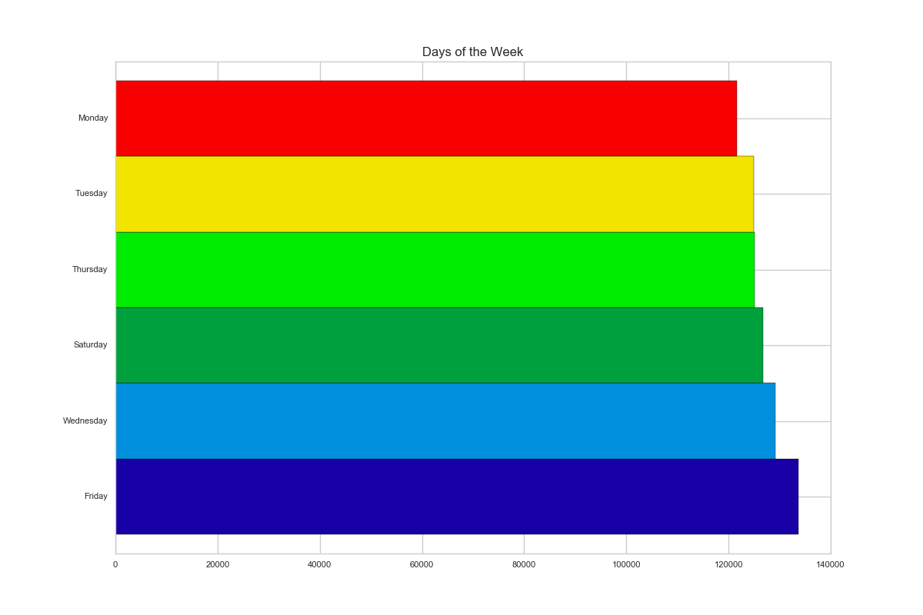
Statistics of Training Data

Slide 8
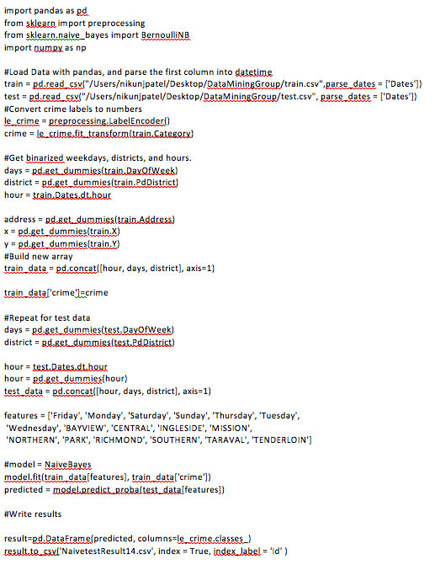
Initial Data Mining Approach
Naïve Bayes
Initially we have selected two features:
Day of week
PdDistrict

Slide 9
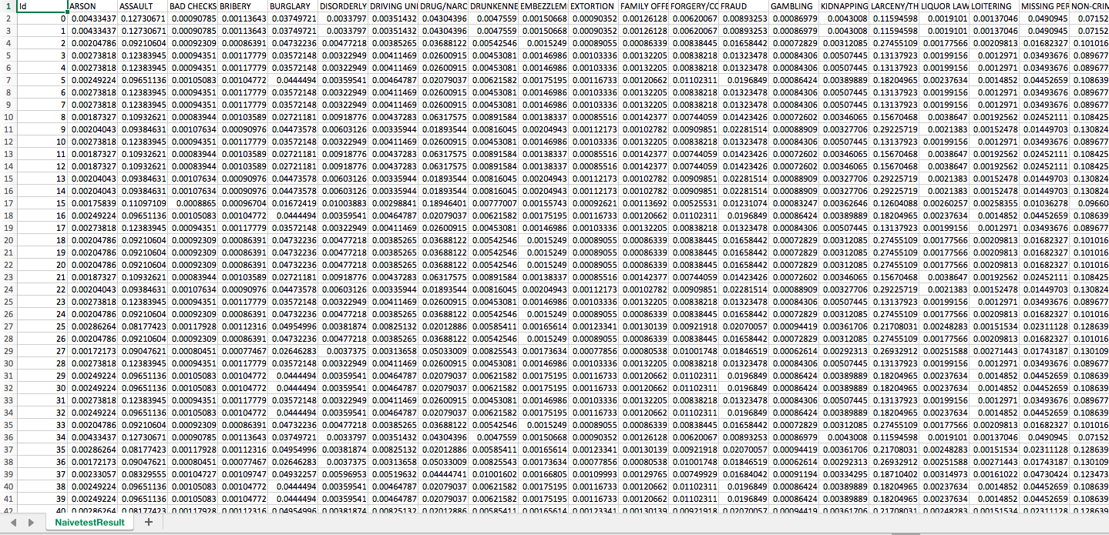

Slide 10
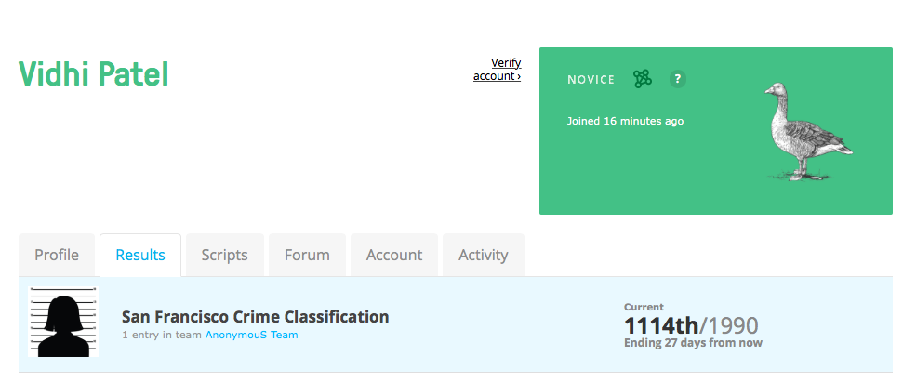
Initial Kaggle Ranking

Slide 11
Final Data Mining Approach
Naïve Bayes
Finally we have selected three features:
Day of week
PdDistrict
time
features2 = [x for x in range(0,24)]
features = features + features2

Slide 12
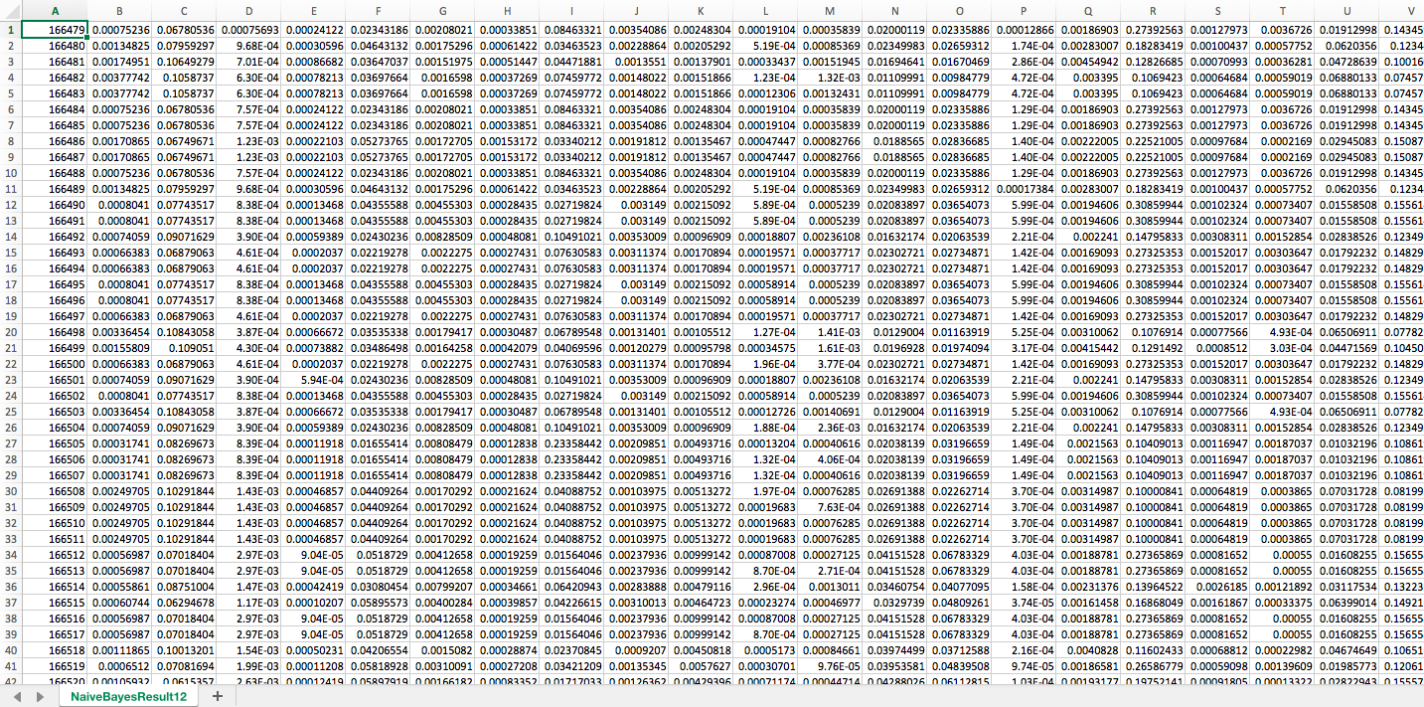

Slide 13
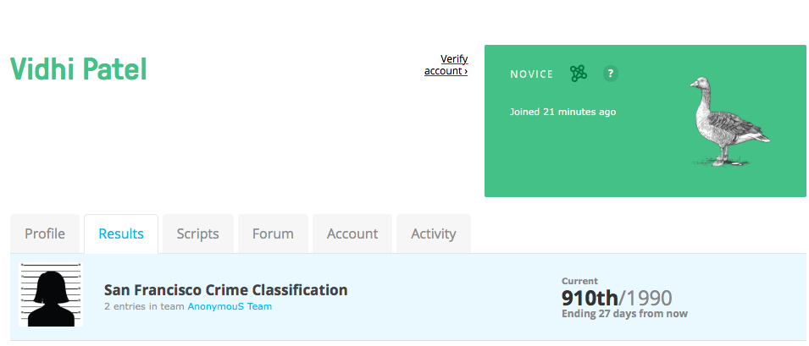
Final Kaggle Ranking

Slide 14
Thank you !!!

